Slide 1
Garden City High School Student Support Services
2020

Slide 2
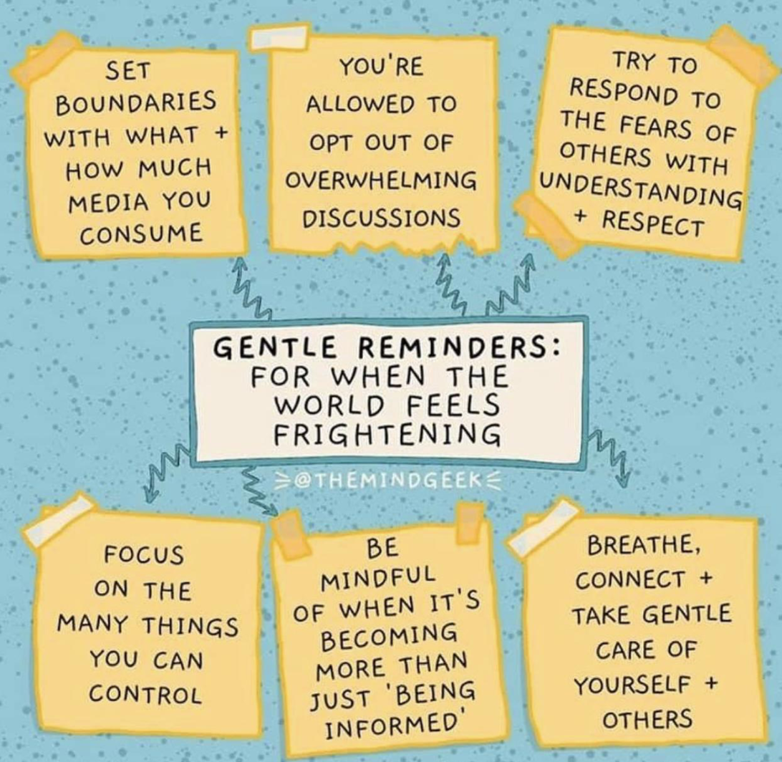

Slide 3
Our Support Team Is Here To Help!
Mandi Stefankiewicz Assistant Principal for Guidance and PPS
stefankiewiczm@gcufsd.net
School Counselors
Timothy Casale casalet@gcufsd.net
Patrick Doyle doylep@gcufsd.net
Jeanne Kennedy kennedyj@gcufsd.net
Natasha Khan khann@gcufsd.net
Jim Malone malonej@gcufsd.net
Karen Whiston whistonk@gcufsd.net
Social Worker
Dina Grappone grapponed@gcufsd.net
School Psychologists
Jessica Berenbroick berenbroickj@gcufsd.net
Brittany Mauceri maucerib@gcufsd.net
Intern 2019-2020 Ryan Shanley

Slide 4
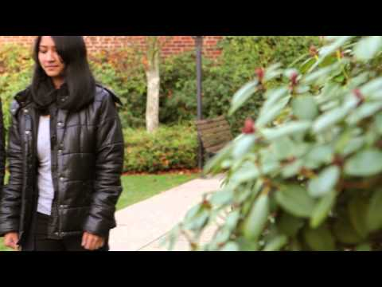
Practice Mindfulness
What is mindfulness?
A moment-to-moment awareness of one’s experience without judgment.

Slide 5
Practice Mindfulness
How to practice Mindfulness
The real work is to make time every day to just keep doing it. Here’s a short practice to get you started:
Take a seat. Find a place to sit that feels calm and quiet to you.
Set a time limit. If you’re just beginning, it can help to choose a short time, such as 5 or 10 minutes.
Notice your body. You can sit in a chair with your feet on the floor, you can sit loosely cross-legged, in lotus posture, you can kneel—all are fine. Just make sure you are stable and in a position you can stay in for a while.
Feel your breath. Follow the sensation of your breath as it goes out and as it goes in.
Notice when your mind has wandered. Inevitably, your attention will leave the sensations of the breath and wander to other places. When you get around to noticing this—in a few seconds, a minute, five minutes—simply return your attention to the breath.
Be kind to your wandering mind. Don’t judge yourself or obsess over the content of the thoughts you find yourself lost in. Just come back.
https://www.mindful.org/how-to-practice-mindfulness/

Slide 6
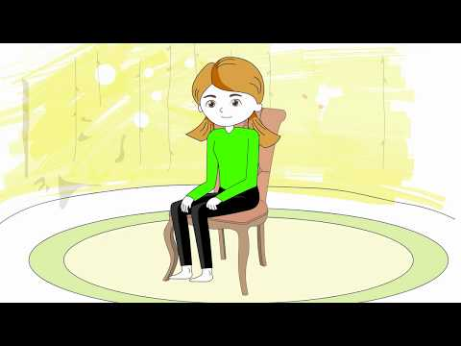
Practice Mindfulness
Video of the “3 minute body scan” technique. Give it a try!
Here are some links to other mindfulness technique videos:
Belly Breathing
5 Senses
Balance Breath
Additional resources
Stop, Breath, Think Youtube Channel
Head Space Youtube Channel
http://mindfulnessforteens.com/guided-meditations/

Slide 7
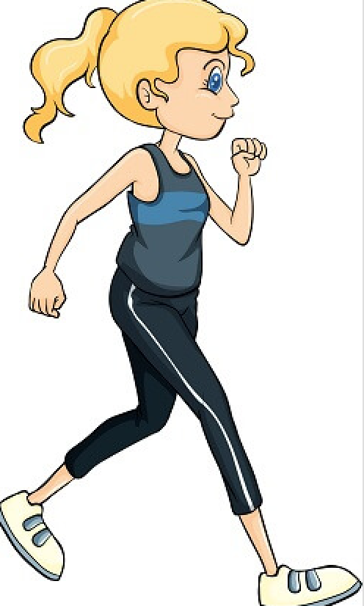
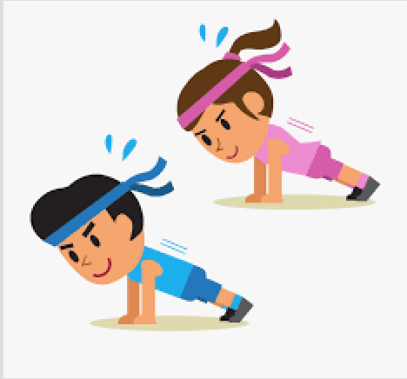
Activities Outside of School
Physical Activity
Take a walk
Go for a run
Go on a bike ride
Utilize YouTube to find:
at-home workout videos
at-home yoga videos

Slide 8
Activities Outside of School
Ted talks
Ted Talk Youtube Channel
Create the ultimate music playlist
Facetime/video chat with friends & family
Journal
Read a book/book series
Listen to podcasts to learn something new!
Radiolab
Stuff You Missed in History Class
This American Life
Stuff You Should Know
Utilize Spotify, Apple Music, or Youtube to find other amazing Podcasts

Slide 9
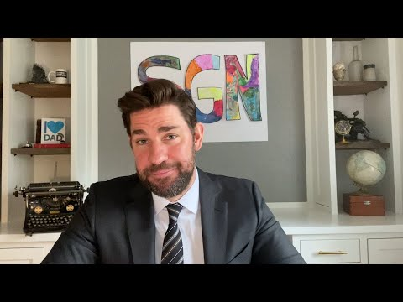
Listen to POSITIVE News
At this time it can be difficult to avoid over-consuming the news. So . . . make sure to get your daily dose of POSITIVE news!

Slide 10
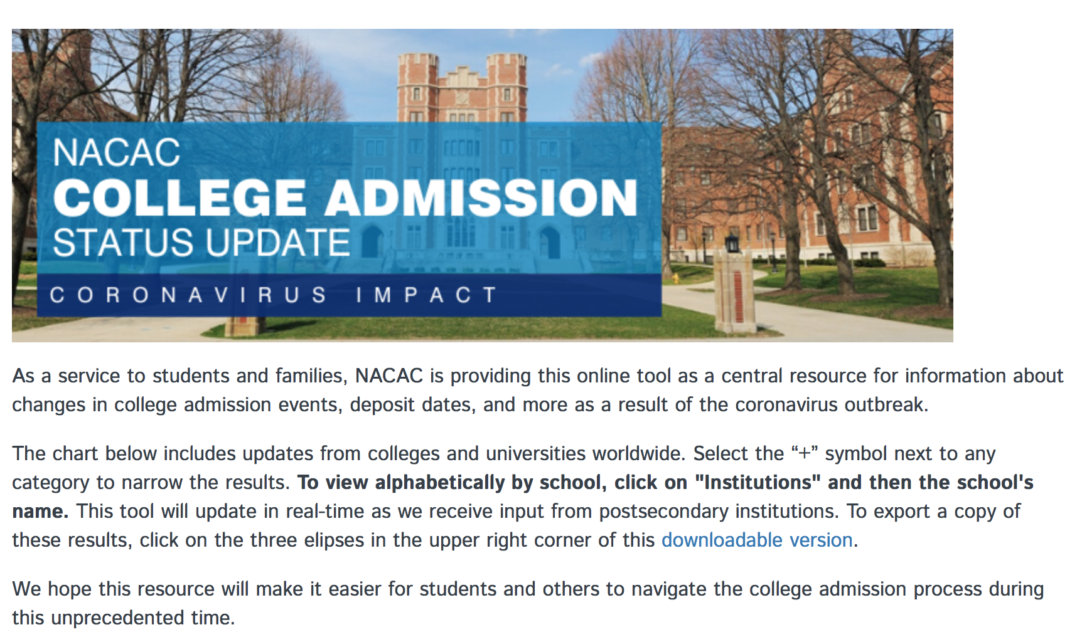
College Search - Virtual Tours & Updates
The National Association for College Admissions Counseling created a central resource for information about changes to college admissions events, deposit dates and the registration process for each college and university.
Utilize the individual websites for each college to take your own virtual tour of campus.
The college search tool on Naviance is another great resource to use.
Reach out to your counselor if you have any questions or concerns about the college search/selection process. We are here to help!
https://www.nacacnet.org/news--publications/newsroom/college-admission-status-coronavirus/

Slide 11
SAT/ACT Help
SAT Updates - Here you will find updates on SAT exams as well as practice material and practice exams
ACT Updates and Resources - Here you will find updates on ACT exams as well as practice material and practice exams. There are also links to sign up for a free online ACT Prep Class & ACT Boot Camp
Additional Resources
Method Test Prep offers free ACT or SAT mini lessons on their Facebook page during school closures
Tune-in every weekday at 11am
Khan Academy has SAT practice material, tips & strategies, and full length practice tests
Through your Castle Learning you have access to SAT/ACT prep material as well as practice exams

Slide 12
We Want To Hear From You
Your counselors are here for you
Check in with us!
Send your counselor an email to make an appointment to talk over the phone or through Google Meet
Join the GCHS Counseling Center and Support Services google classroom

Slide 13
Most Important Takeaways!
Take care of yourself
Spend time with family and virtually connect with friends
Carve out time to decompress and have fun
Pay attention to the positives
Access resources and supports for any and everything
Reach out to us as often as you need
We are all in this together!

Slide 14
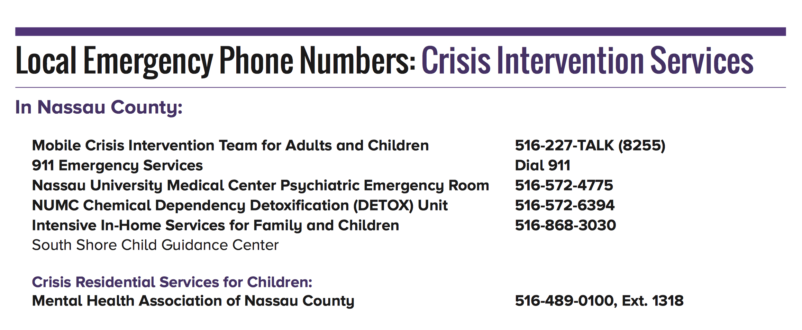
Additional supports if you are in crisis
https://www.gardencity.k12.ny.us//cms/lib/NY01913305/Centricity/Domain/1041/Crisis%20intervention%20resource.pdf

Slide 15
Additional supports if you are in crisis
New York State free hotline offering emotional support, consultation, and referral to a provider. If you need to talk to someone beyond your school support and family, call 1-844-863-9314 to access to over 6,000 volunteer mental health providers.
Garden City Mental Health and Wellness Resources
https://www.gardencity.k12.ny.us/cms/lib/NY01913305/Centricity/Domain/4/GC%20Mental%20Health.pdf

